Slide 1






Webinar series 6 May 2026
Carrying the System: Women’s Invisible Burden in South Africa’s Childcare System
Lerato Shai

Slide 2
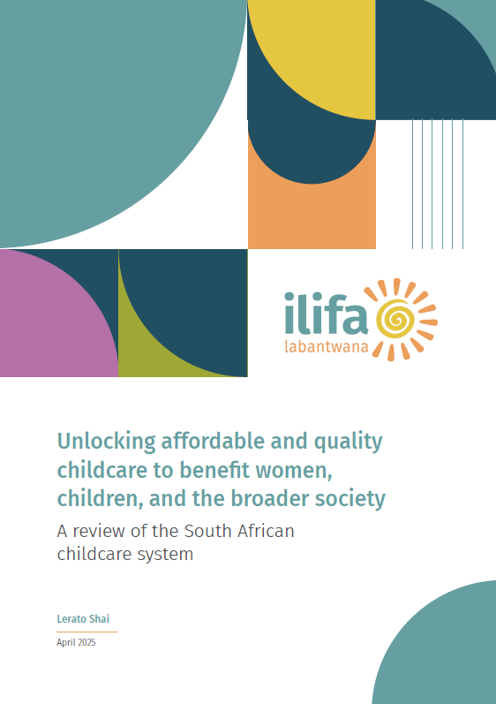
Content
1. Setting the scene: locating the childcare system in South Africa’s care regime
2. Overview of South Africa’s childcare system: deep dive into childcare provision and gender norms
3. Conclusion: a system falling short of unlocking all the benefits of childcare
4. Recommendations: Critical actions to shift the state of the system

Slide 3






Setting the scene

Slide 4
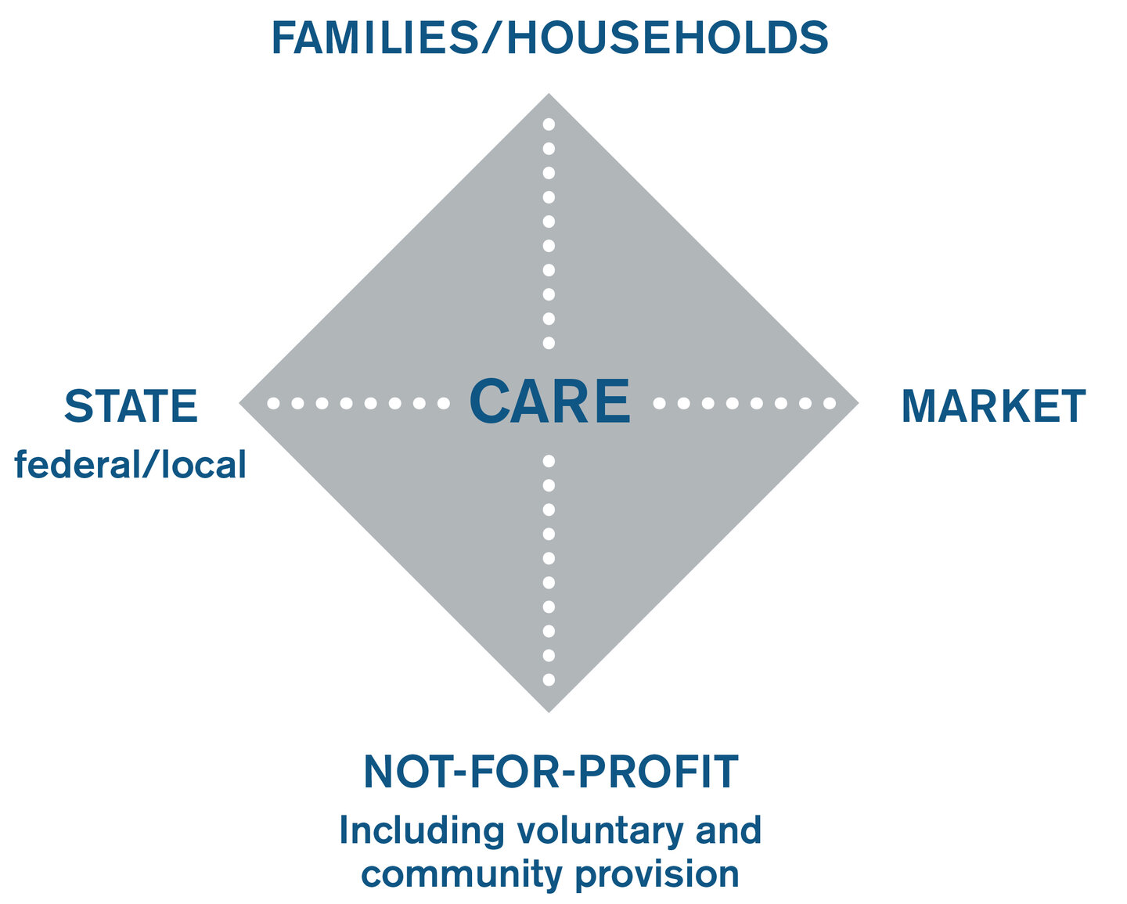
What is a childcare system?
A set or network of services, policies, regulations, resources and infrastructure that the state, not-for-profit sector, markets and families/households collectively provide to support the care of children from birth to age six to enable families (particularly women) to balance their caregiving and other responsibilities.
Razavi’s (2007) posits a distinct and pivotal role for the state as a decision-maker whose actions shape the responsibilities assumed by other institutions within the
diamond
8

Slide 5
South Africa’s care regime – a hybrid system shaped by inequality (1)
Policy design centres the family
1997 White Paper for Social Welfare and the 2012 White Paper on Families place the family as the primary provider and assign the state a supportive role and is criticized for ignoring gendered patterns of care provision.
The 2021 Revised White Paper on Families takes this criticism into account; however, it continues to see the role of the state as supportive and fails to include indicators to monitor gender and parental division in childcare work (Hatch, 2023).
Dual system shaped by apartheid legacy persists along income, gender and racial lines
Formal care regime accessed by high-income households has retained “liberal” features (Button et al., 2018).
These households buy childcare and domestic labour, insure themselves and purchase personal care in their homes or private institutions when members reach old age.
The informal care regime largely accessed by Black African households is characterised by continued dependence on the family (primarily women) and has thus retained conservative features (Mahon, 2018).
Sustained by women’s unpaid and underpaid care labour
Neoliberal economic policymaking and programming
Neoliberal reforms reduced the state’s role in direct provision of services (e.g. GEAR) leaving other institutions within the care diamond to close this gap
This persisting neoliberal architecture of the South African economy is argued to continue to explain the significant gaps in the provision of quality care.
These gaps are imperfectly addressed through markets and largely resolved through a reliance on the unpaid and undervalued care labour of women (Kasan, 2024).
The care regime relies on a hybrid model but in practice it is sustained by the unpaid and underpaid care work of women.
n

Slide 6
Blind to gender dynamics thereby reinforcing gendered patterns of care.
Gendered nature of care within families is largely invisible or under-acknowledged in policy and programming but are both blind to the gendered nature of care provision within families
The care regime’s reliance on women is made possible by South Africa’s patriarchal system that privileges men over women, which includes harmful gender norms and attitudes that violate women’s rights and lead to structural gender imbalances in the provision of care.
South Africa’s care regime – a hybrid system shaped by inequality (2)
A long legacy of family disruption
Family structures have undergone dramatic structural changes: extended family living, African children not residing with biological fathers.
The migrant labour system, over decades of institutionalised racial segregation under the apartheid regime, scaled up and entrench patrilineal system’s normalisation of extended family living as the dominant family structure in the country.
Female primary caregivers in mother-only or neither-parent households are primarily assisted solely by other women.
HIV/AIDS epidemic, high levels of unemployment and significant increase in the value of the Old Age Pension are key factors that have restructured the role of older people in family networks in South Africa.
The reproduction of inequality remains central to the architecture of South Africa’s care regime, resulting in its failure to comprehensively address the needs of South African families and unlock care’s social and economic benefits.
n

Slide 7
South Africa’s childcare system

Slide 8
Components of South Africa’s childcare system
Childcare system component | State | Markets | NPOs | Families/ households
Programmes and provisioning
Childcare provision | x | x | x | x
Social assistance/cash transfers | x
Maternal and child health programmes | x | x | x
Family and caregiver support/strategies | x | x | x | x
Public and private funding
Subsidies to parents for childcare | None
Subsidies to childcare providers | x |  | x
Incentives for employers | None
Tax regime support | None
Policies and legislation
Public entitlements | x
Parental and family leave | x | x | x
Child maintenance | x |  | x | x
Prevailing gender norms and attitudes
Shifting gender norms | x | x | x | x
Essential package of ECD services

Slide 9







Childcare provision

Slide 10



Programmes
42 000+ programmes, mostly small and community based
Self-starting providers dominate
Weak formal support, monitoring and uneven quality
Workforce
198 000+ workers
Operating independently
Low and unstable incomes
Limited ability to hire staff, invest or expand
Funding
69% of programmes rely primarily on fees
R24 per child per day subsidy (far below cost of provision)
Only 27% of the 2.3 million eligible children currently receive the subsidy
The state of childcare provision (specifically ECD programmes)
Supply exists but it is fragmented and poorly supported
Strong workforce that is severely economically constrained
System is primarily privately funded with partial subsidisation
Child access
1 million+ children aged 3 to 5 do not have access
77% of non-enrolled children excluded due to inability to pay fees
Learning outcomes
Only 42% of children aged 50 to 59 months are developmentally on track
82% not on track in atleast one domain
Quality varies widely across different context
Regulatory context
Registration acts as a gateway funding but complex requirements and processes exclude many providers
Policy and funding are misaligned — early learning is treated as education in policy, but funded as a partial welfare subsidy
Demand is suppressed by affordability
Unequal access and quality produce unequal learning outcomes
Strong policy intent but funding level and design misaligned

Slide 11
Who carries the childcare system?
1. Women absorb unpaid care burden
3. Women shoulder the administrative burden
6x
Women perform 6 times more unpaid care of persons than men
95%+ of Child Support Grant recipients are women, reflecting their role as primary caregivers.
Women are the primary users of the maintenance system, reflecting their role as primary caregivers and the burden of securing financial support for children.
2. Women sustain the childcare workforce
4. Women bear the economic penalties
90%+ of the ECD workforce is female
1.8 million
(88%)
54.0% of women participate in the labour force compared to 64.6% of men
of the more than 2.0 million labour force participants who reported not working because of family considerations or childcare are women.
Majority of ECD workers earn below the National Minimum Wage
Sources: StatsSA 2010, Commission for Gender Equality 2021, DBE 2021, StatsSA 2025, General Household Survey 2024

Slide 12



A structural contradiction: regulated as education, funded welfare
Childcare performs three functions simultaneously…
1. Care and supervision
2. Labour market enablement
3. Early learning and development
Children need to be safely looked after while adults work, search for work, or manage household survival.
An economic enabler, especially for women. It reduces time constraints, allows participation in work (in the sector and elsewhere), education or income-generating activity
Organised programmes support cognitive, language, social-emotional and physical development, and therefore matter for later educational trajectories.
…BUT the system is misaligned
      Policy discourse and regulation increasingly emphasise the third function, early learning (education).
      Current child welfare funding model reflects the first function. Families are expected to secure care privately and pay what they can and the state subsidises
      The second function, labour market enablement, remains under-addressed, even though it provides a strong public-interest rationale for state funded early learning.
      The current model tries to produce education outcomes with welfare-like funding and private-household driven cost recovery.
      Provision continues to operate through a market-based model in which services expand where they are financially viable. Quality and access continue to vary across contexts.
The system remains caught between two logics: one in which access is shaped by economic viability, and another where it is expected to be universal and equitable. To resolve this tension, we need to rethink our reliance on market mechanisms to deliver a service with strong public-good characteristics.
n

Slide 13
What changes for women when childcare systems work?
Evidence from the Global South
Argentina
Latin America and the Caribbean
On average, 13 mothers started to work for every 100 youngest children that attended pre-school (Berlinski et al., 2011).
Significant effects of childcare on maternal labour supply, noting that this evidence was consistent regardless of the type of arrangement (formal or informal) used for childcare (Diaz & Rodriguez-Chamussy, 2013).
Uruguay
Burkina Faso
Where childcare programmes merely substitutes informal arrangements, it may have little to no effect on women’s labour force participation (Batthyány & Genta, 2020).
Positive effects on women’s employment and a greater impact from women securing jobs as childcare providers (Ajayi et al., 2022).
Design conditions (Halim et al., 2021)
Whether it was designed with or without the mother in mind (opening hours)
Child’s age: women found to be more willing to place older children and maternal labour outcomes found to be strongest for ages 3 to 8 years old.
Targeting low-income households: mixed results were found for concentrating on low-income households. (economic opportunities are low hence complementary support required)
Brazil
Publicly provided daycare programme led to rise in labour force participation which was primarily driven by grandparents and adolescent siblings, not parents, as many were already working. (Attanasio et al, 2022)

Slide 14
Shifting gender norms and attitudes

Slide 15
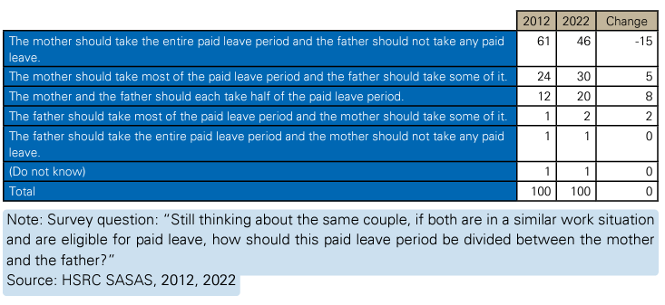
The state of gender norms and attitudes in South Africa
59.6%
women
Ever-partnered women/men agreed that a woman’s most important role is to take care of her home and cook for her family.
66.6%
men
69.5%
Of men believe that a woman should obey her husband
Despite high levels of unemployment, South African men are still expected to be the primary breadwinners (Rabe, 2021).
The State of Fathers’ report of 2021 found that unemployed and poor men who are unable to provide for their children often face shame and humiliation and are more likely to disengage from their families (Malinga, 2021).
The HSRC 2024 study of Gender-Based Violence in South Africa finds that South African society remains deeply patriarchal, with widely held views by both women and men that a woman’s place is in the home (Zungu et al., 2024).
Notes:
Tb5 has affirmed our strategy in a number of fronts i.e the role of NGOs to improve quality access, support for parents i.e. SbS and the responsive care strategy we will speak to today
We won’t got to the data points per se.

Slide 16
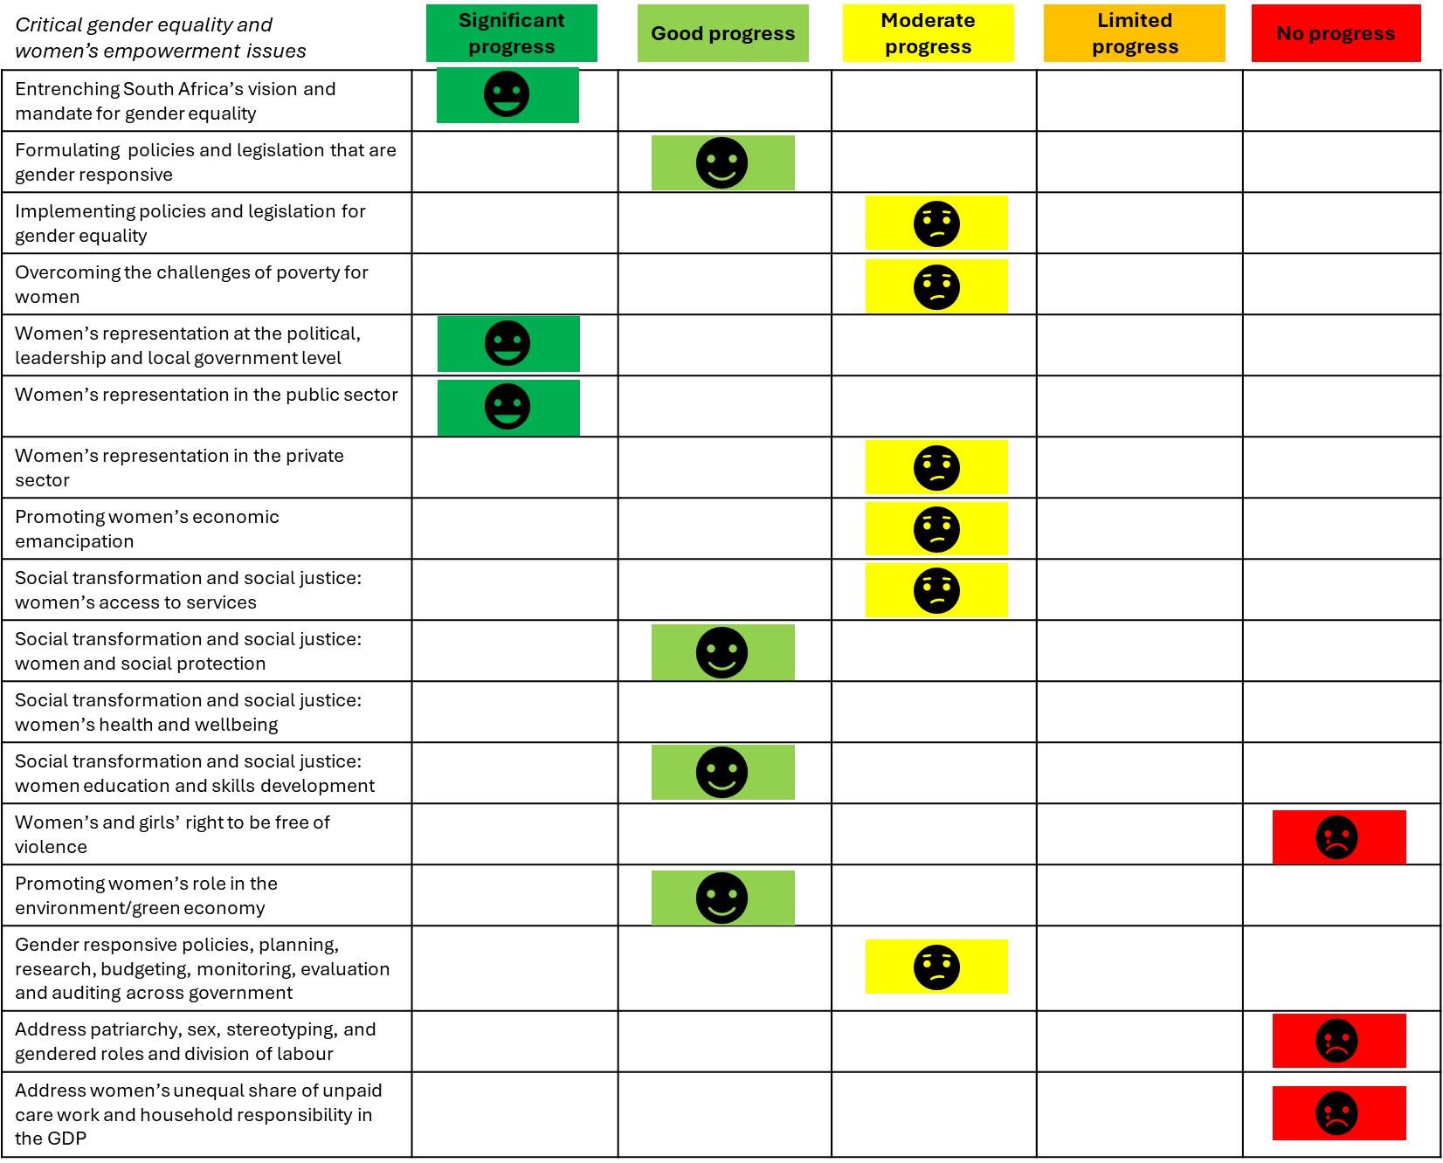
The state of norm-shifting efforts
Norm-shifting efforts rarely address the biggest norm of all: that families, and especially women, should absorb care when the state and market fail.
A critical gap is interventions that seek to shift norms around distribution of care work between families and the state, emphasising the recognition of care as a public good for which the state should play a greater role.
Beijing Platform for Action South Africa’s 2024 self-assessment of progress with respect to gender equality and women empowerment issues in the

Slide 17
Conclusion

Slide 18
In closing…
1. The review shows that South Africa’s childcare system currently relies on women’s unpaid and underpaid labour to compensate for gaps in public provision, funding and support.
2. While important progress has been made in ECD, policy and funding continue to driving this agenda without locating it within the broader childcare system and treating childcare as essential social and economic infrastructure
3. Our efforts have centred on realising children’s rights and their development outcomes and largely considered women’s outcomes as a secondary. This is despite a commitment to gender equality and women’s economic participation
4. Unlocking the full benefits of childcare requires a shift towards integrating both children’s and women’s rights within a holistic view of the childcare system and recognising of childcare as a public good that necessary for socio-economic wellbeing
18

Slide 19
Recommendations

Slide 20
Critical actions to shift the state of the system
Recognise and fund childcare as a public good for which the state has primary responsibility
Adopt a systems approach to childcare policy, planning and programming .
Increase and reallocate funding to ensure sustainability and equity across all system components.
Implement existing recommendations on service provision and child maintenance enforcement.
Close national data and evidence gaps e.g. causal effect of childcare on women’s labour market outcomes
Launch a coordinated, long-term national campaign and design interventions to shift societal norms around care.

Slide 21


Thank you!
www.ilifalabantwana.co.za

